Slide 1

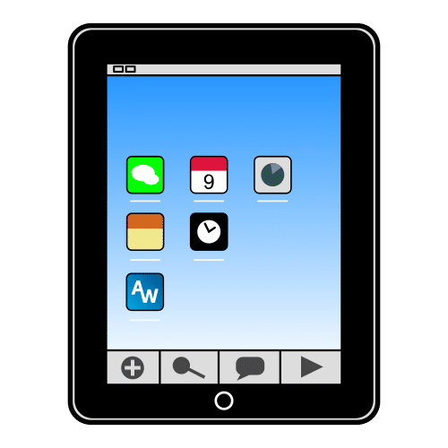
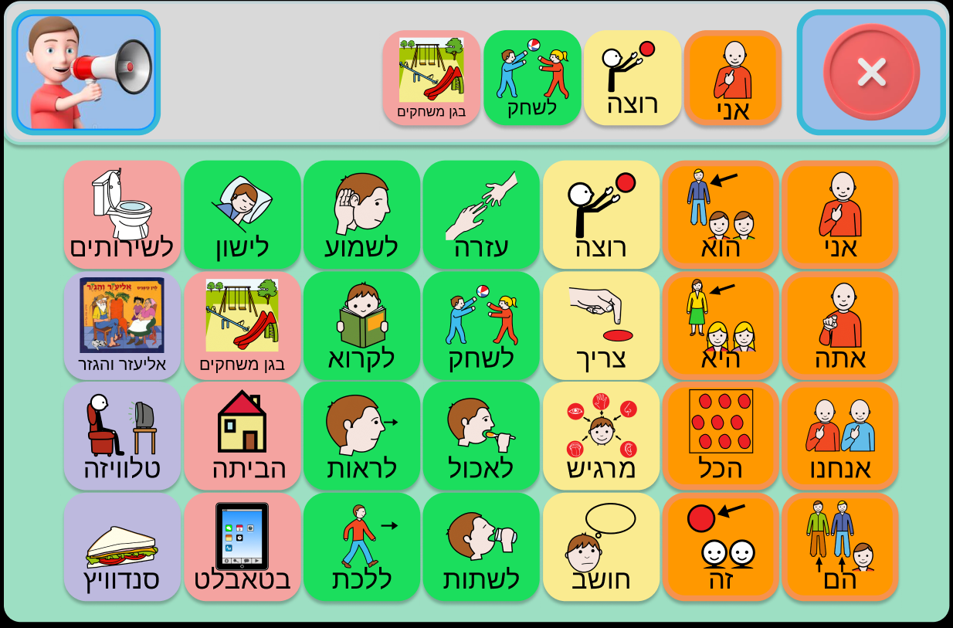
Diburnik
Communication Board Application Intended For Children
With Complex Communication Needs
Capstone Project Phase 2
23-2-D-6
Presented by:
Nadav Cohen
Sharon Snitivker
Supervisor:
PhD Julia Sheidin

Slide 2
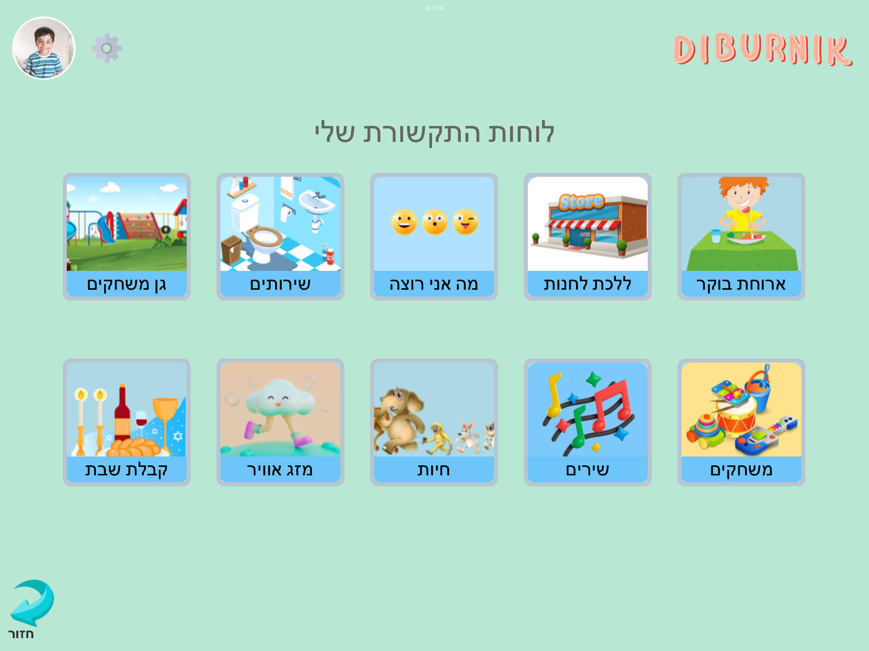
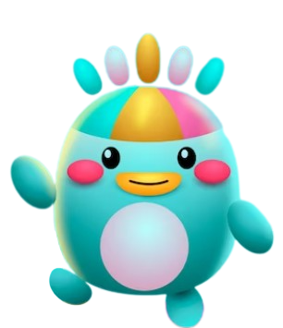
01
INTRODUCTION
Notes:
שרון

Slide 3
What are Complex Communication Needs (CCN) ?
Complex Communication Needs (CCN) are resulting from a wide range of developmental disabilities such as: autism spectrum disorders, cerebral palsy, down syndrome, and other special needs.
Children With CCN
Often do not develop speech and language skills as expected.
Their speech abilities may be limited
They might experience delayed speech development or have speech that is difficult to understand
These communication challenges can result in them being:
Severely restricted in their ability to communicate effectively with others
Making their needs and wants unknown
Notes:
שרון

Slide 4
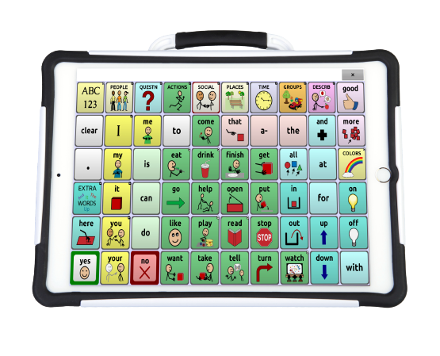
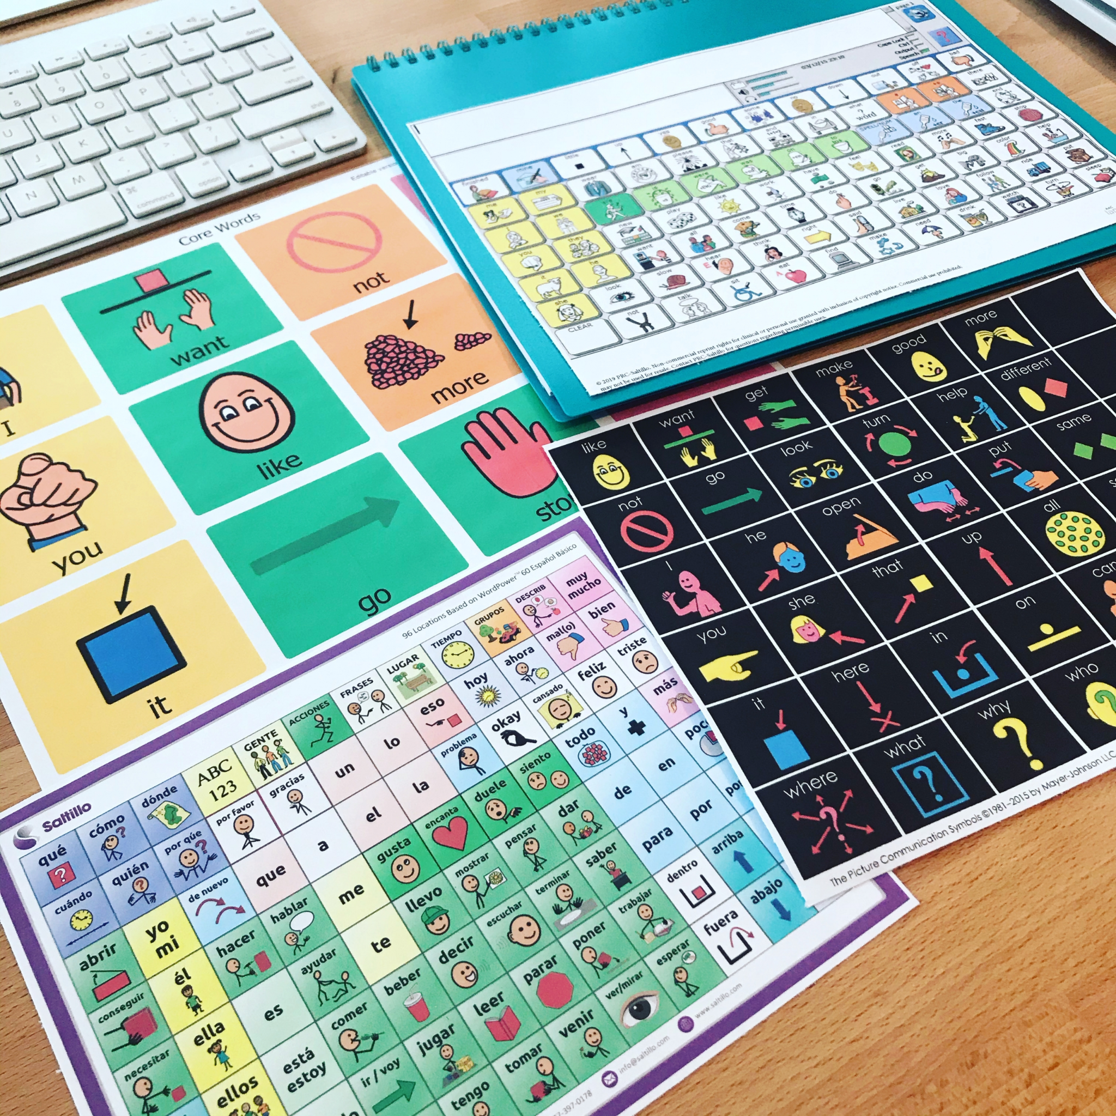
What is a Communication Board ?
Communication Boards are a distinct category within the broader field of Augmentative and Alternative Communication (AAC) tools. They are visual displays utilizing symbols, pictures, or words to aid individuals with speech challenges in expressing themselves, facilitating effective interaction through both low-tech and high-tech variants.
Image Source
Image Source
Notes:
שרון

Slide 5
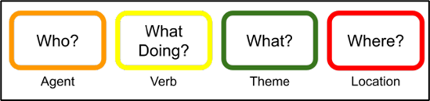
Colorful Semantics (CS)
The main advantage of CS is the identification of semantic roles, including the agent, verb, theme, and location.
This method provides support to children with a limited vocabulary in organizing the grammatical content of their sentences.
Utilizes a system of colors associated with questions to represent the semantic roles of sentence elements.
Colors are used to visually distinguish between each role.
Notes:
שרון

Slide 6
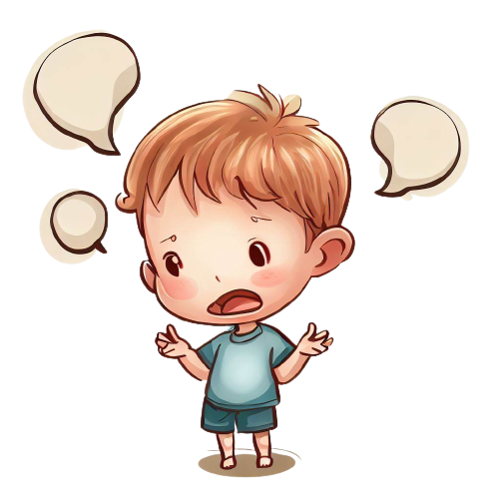
The Problem
Children with CCN face challenges in expressing themselves due to conditions like learning disabilities, autism spectrum disorder, brain injuries and more.
These conditions hinder their ability to communicate effectively through conventional means.
Current solutions are expensive.
Current solutions are impractical for children
Current solutions require the children to use their personal tablet device to access their custom boards.
Notes:
שרון

Slide 7

Our Collaboration
We collaborated closely with “Eshkol Geni Yuvalim”, a kindergarten campus , located in Upper Afula.
The campus is a home for children between the ages of 3 and 7 who have complex disabilities such as: cerebral palsy and /or developmental delays of varying levels.
Initially, our requirements were shaped by Mr. Offer Gann who outlined his vision for a communication board application. Later, we decided to focus on children, and refined our requirements based on teachers and speech therapists from kindergarten.
Our application could also be adapted to meet the needs of adults instead of children.
Then, we supplied them with a prototype to get an initial feedback and remarks in order to make the needed modifications.
Their close involvement resulted in a final product that met their needs and garnered positive feedback upon the final product.
Notes:
שרון

Slide 8
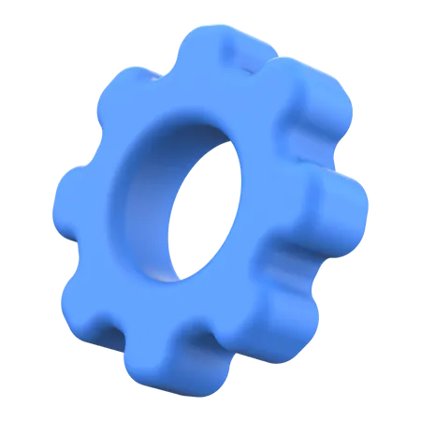
02
Main Features
Notes:
נדב

Slide 9


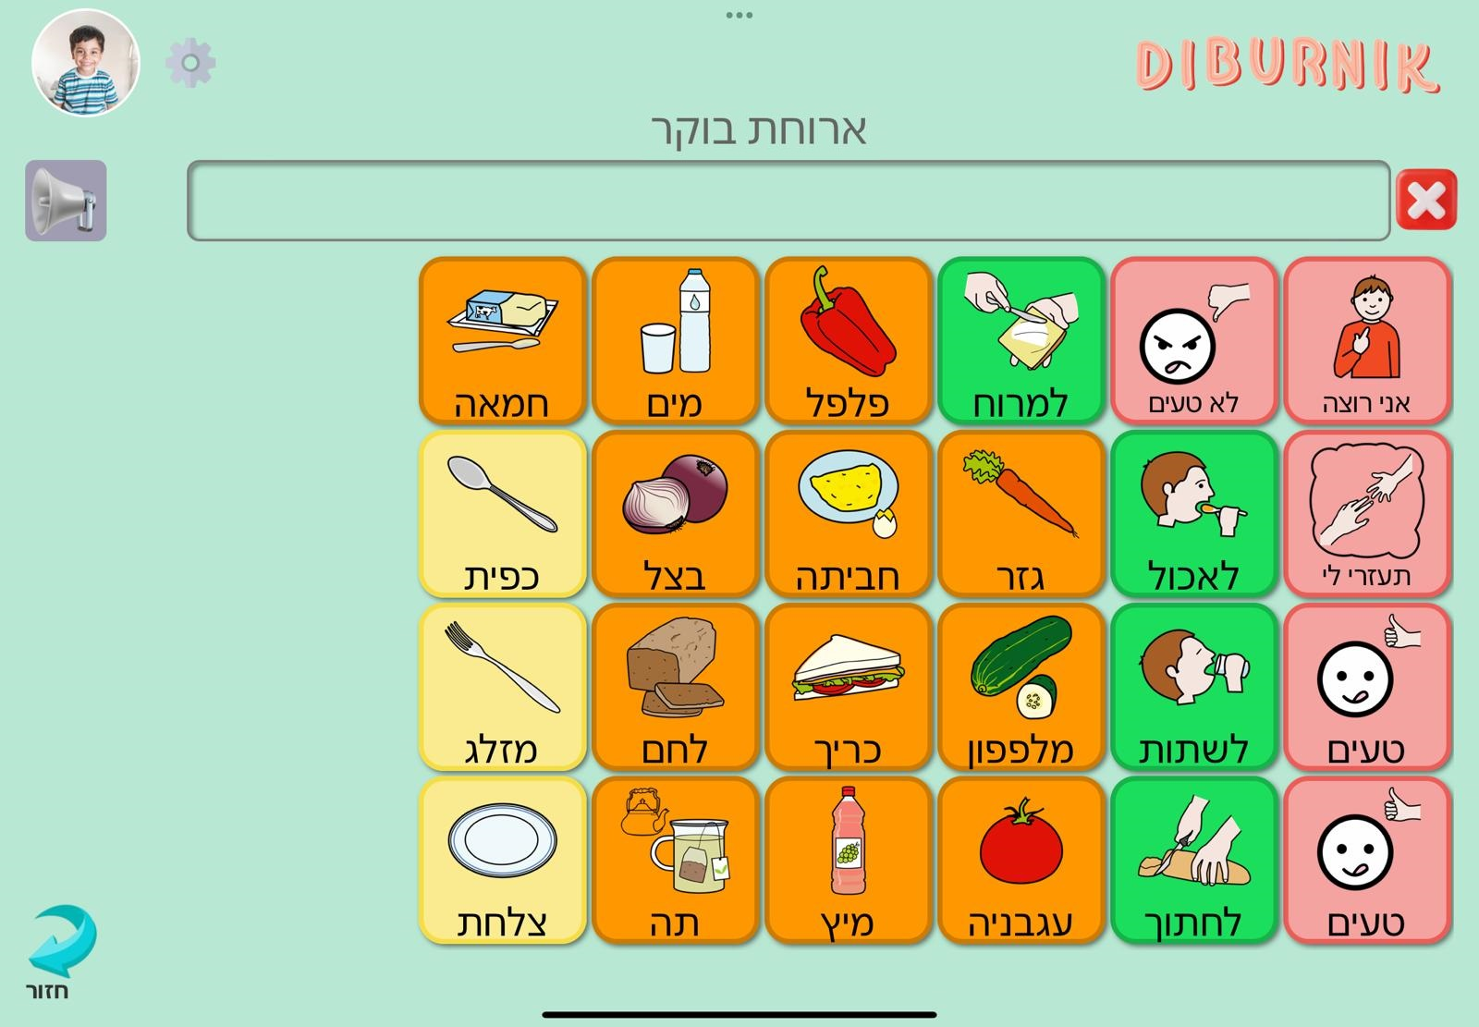
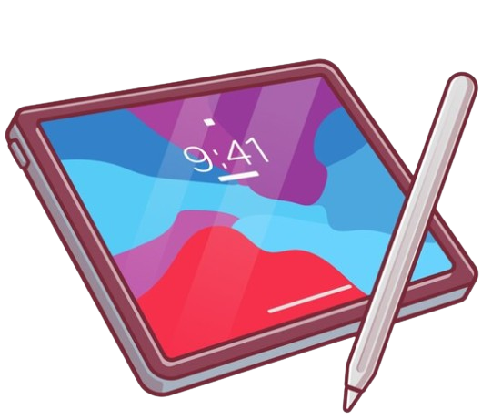
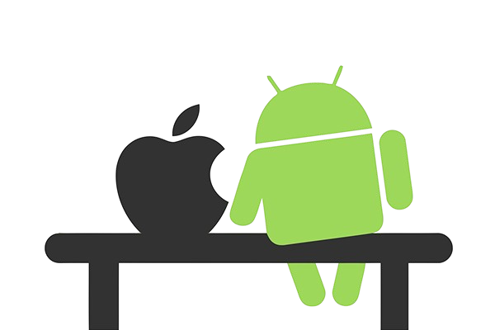
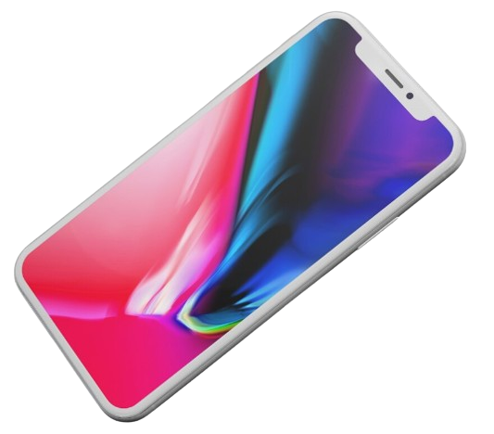
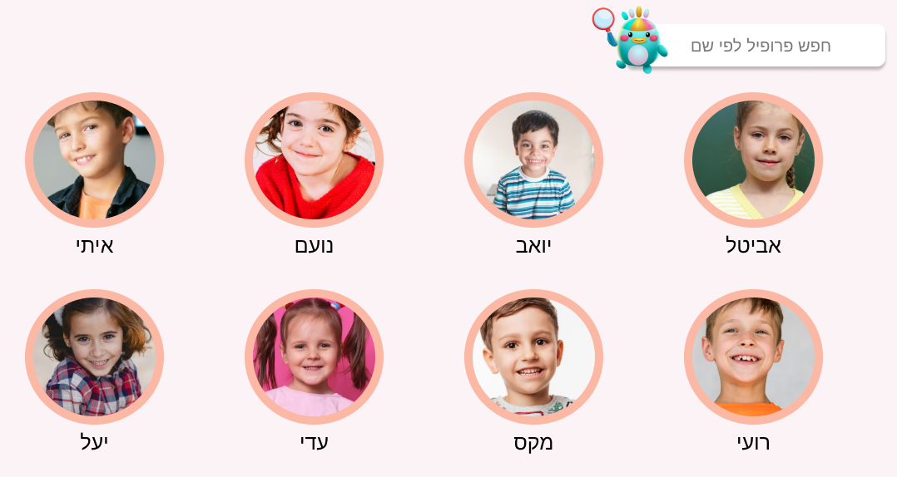
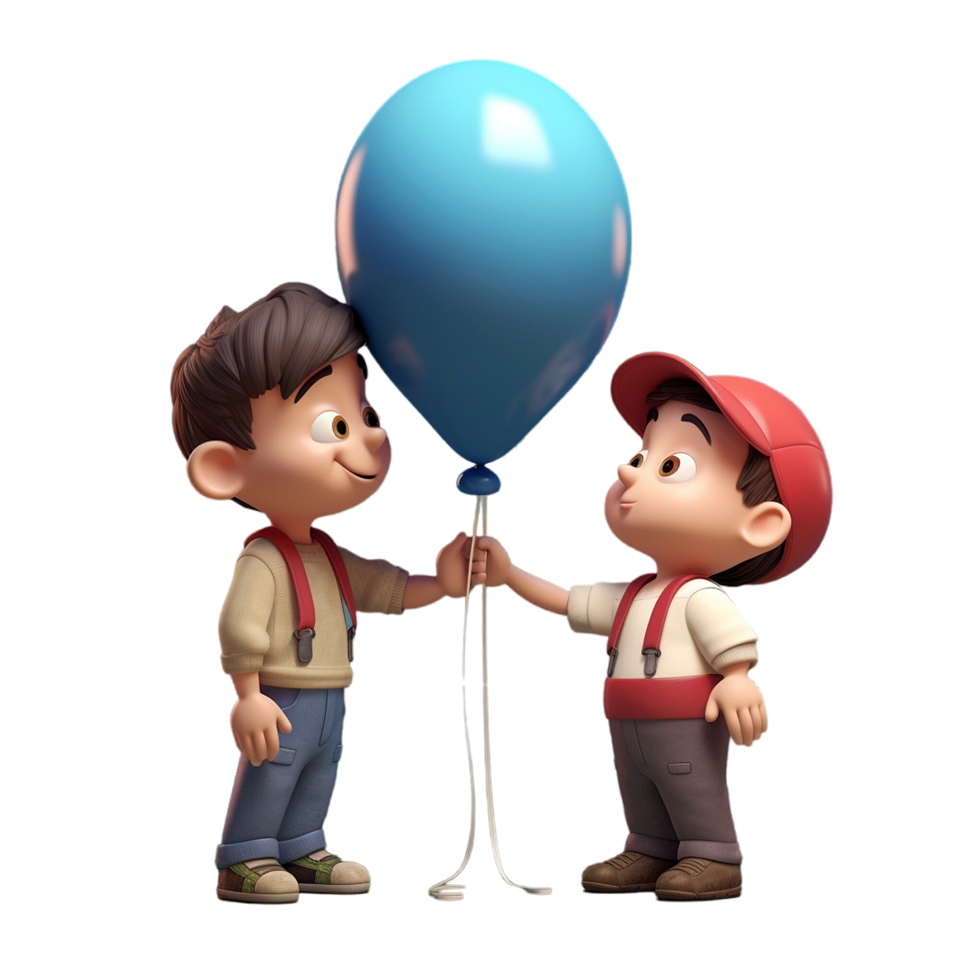
Main Features
Users Profiles
Communication Board
Cross Platform Application
Accessibility to the customized communication board from any device the application is installed on
Allowing multiple users to be logged-in to the same device simultaneously
Variety of communication board types for diverse subjects
Supporting both iOS and Android platforms
Customized for both tablets and mobiles
The GUI is designed to be child-user-friendly
Notes:
נדב

Slide 10
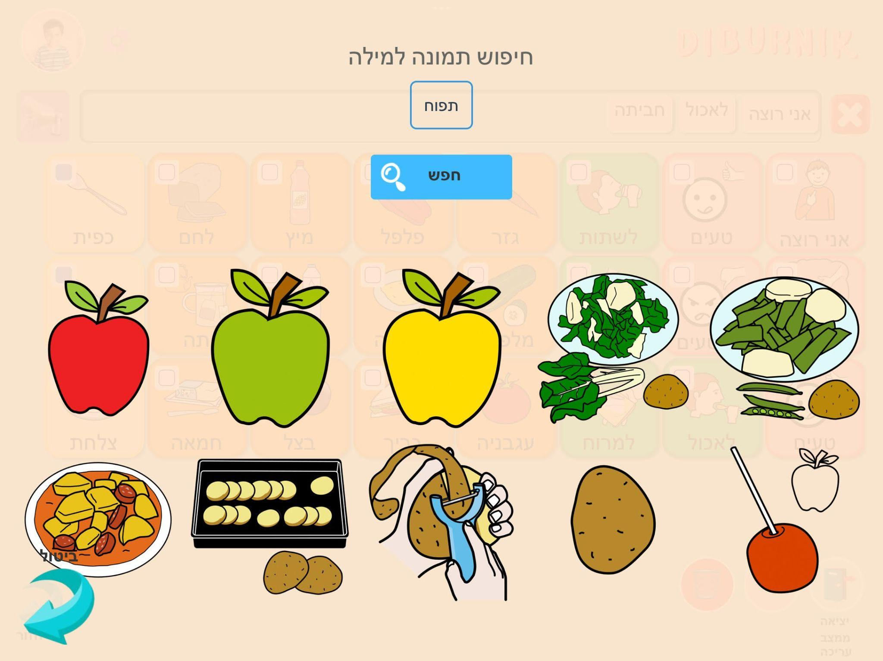
Main Features
Pictograms Search
We aimed to adopt a similar set of pictograms commonly used in communication boards
We utilize an API that supports Hebrew, assisting in word searches and providing appropriate pictograms for communication boards
Notes:
נדב

Slide 11
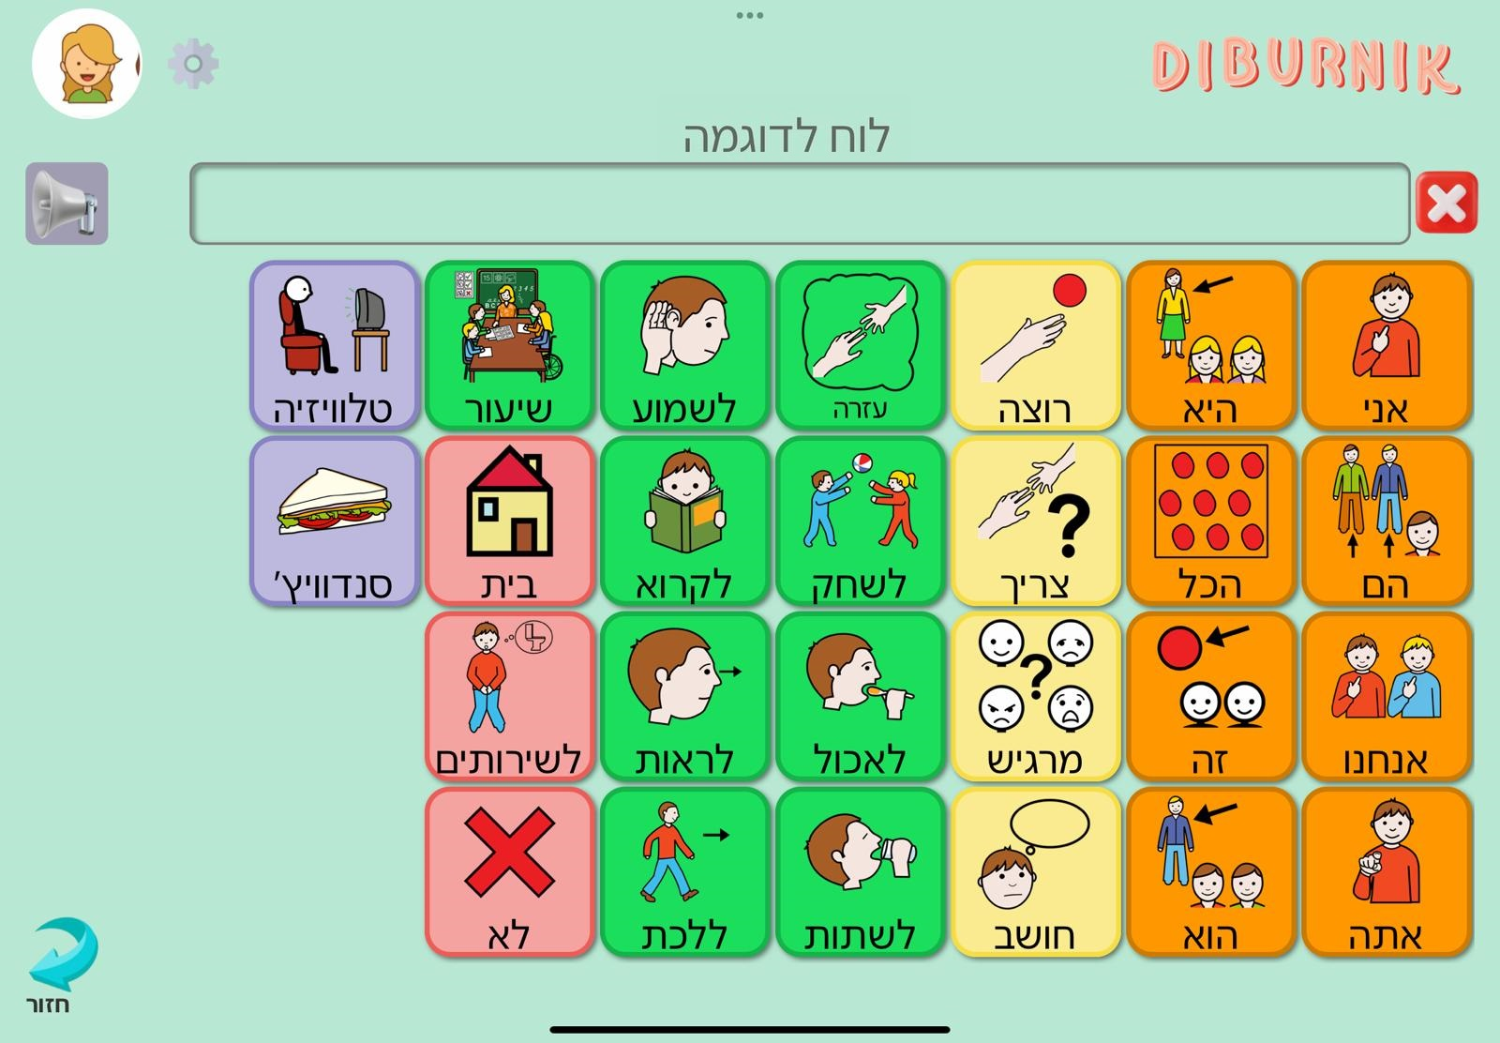
Main Features
Colorful Semantics (CS)
The speech therapist assigns colors to words according to their semantic roles
Examining the colors of the words can simplify the process of sentence construction for the child
Notes:
נדב

Slide 12

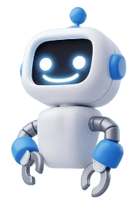
03
Technologies Used
Notes:
נדב

Slide 13



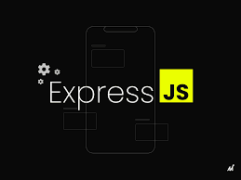


Technologies Used
Frontend:
Backend:
Data Base:
Notes:
נדב

Slide 14

04
Achievements
Notes:
שרון

Slide 15
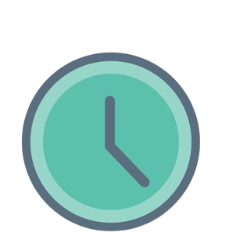
Achievements
1. Effective communication and independence:
The child's ability to effectively communicate with his surroundings independently
2. User satisfaction:
Feedback from both the child and the adult users indicate a high level of satisfaction with the application, including its usability, features, and overall experience.
3. Long-term impact:
The project should have a lasting impact on the child's development, providing benefits that extend beyond the duration of their engagement with the application.
Notes:
שרון

Slide 16

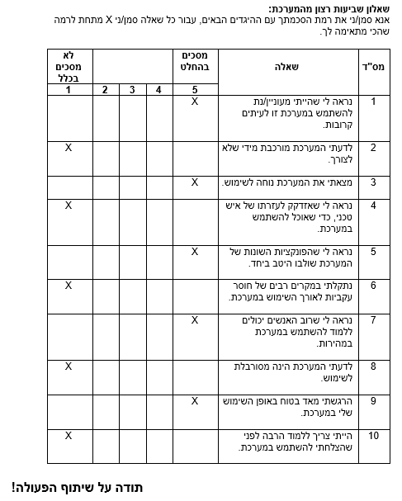
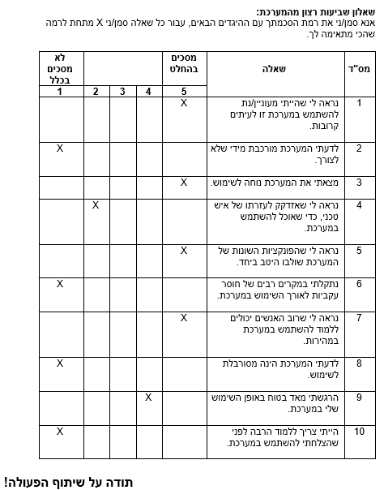
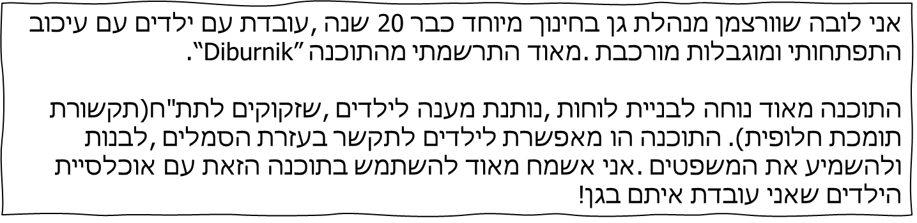
Achievements
Notes:
שרון

Slide 17

05
Demo

Slide 18
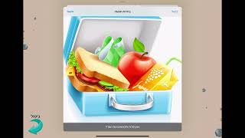
Demo

Slide 19
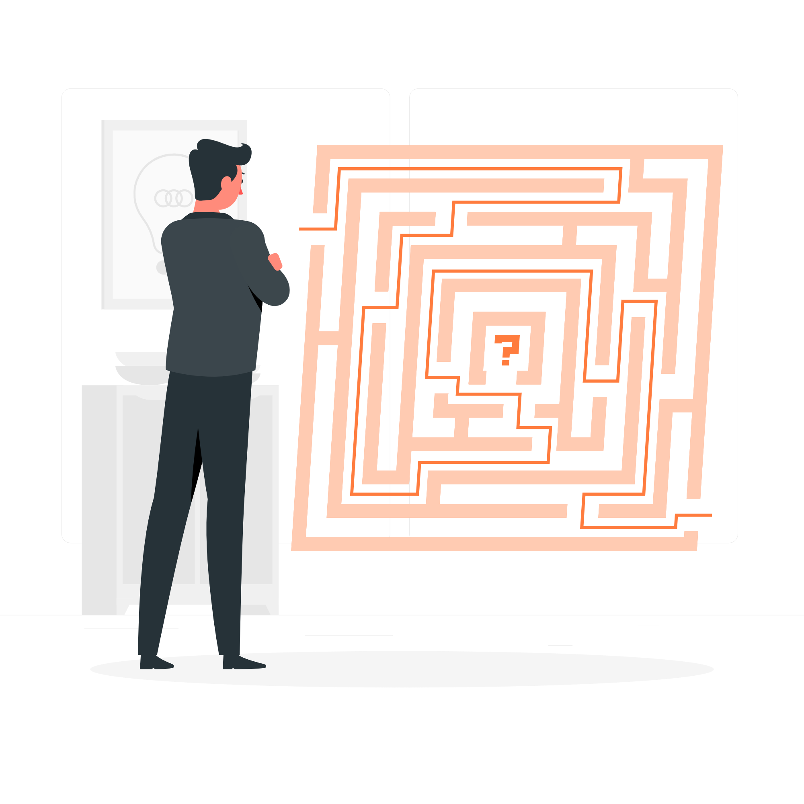
06
Main Challenges
Notes:
נדב

Slide 20

Main Challenges
1. Cross-Platform Compatibility: We had to ensure our application worked well on both iOS and Android devices.
Despite utilizing React Native, achieving uniform functionality was not always straightforward, necessitating optimizations tailored for each operating system.
2. Loading Times and Offline Usage: Our application initially experienced delays in downloading pictograms from the database, resulting in potential wait times for users.
To address this, we developed a customized cache system and reduced the images resolution, significantly improving loading speeds.
Additionally, this system allows our application to function offline after the initial board download.
Notes:
נדב

Slide 21
Main Challenges
3. Backend Deployment Timeout: Our backend deployment shuts down after 15 minutes of inactivity, causing delays for users as it takes time to "wake up."
To solve this, we set up a cron job triggering an HTTPS GET request every 14 minutes, keeping the backend active. This approach minimized delays, ensuring a smoother user experience.
4. UI Optimising: Ensuring a consistent appearance across various resolutions and screen sizes was crucial for our application, aligning with our initial design plans was equally important.
To achieve this dual objective, we implemented a dynamic solution that adjusts element sizes and positions based on the screen resolution while striving to maintain fidelity to our original design vision.
Notes:
נדב

Slide 22

07
Conclusions
Notes:
נדב

Slide 23
Conclusions
Very simple and convenient user interface , suitable especially for “Eshkol Geni Yuvalim” kindergarten campus.
Allows switching between the different children user profiles
Completely free application
Supports Hebrew
Notes:
נדב

Slide 24

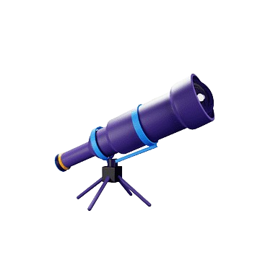
Conclusions - Future Work
We developed a generic application that can be easily be modified to be compatible also for adults
We can expend the application to support different types of voices
We can expand language support to include additional languages
Notes:
נדב

Slide 25
Thank you for listening!
The End
Does anyone have any questions?

